Slide 1
NeLS: Data transfer and organization
Tina Višňovská
ELIXIR Norway, Norwegian e-infrastructure for Life Sciences and usegalaxy.no

Slide 2
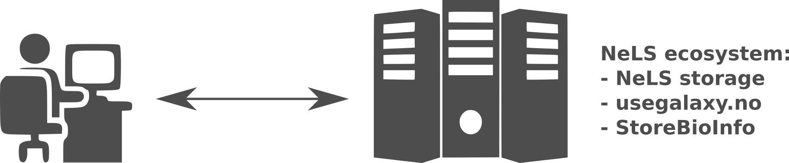
Why to transfer data to and from NeLS?
To organize, share and safely store and archive data on NeLS, one has to get the data there.
To import data to a national Galaxy server (usegalaxy.no) is faster from NeLS than from elsewhere, since there is direct high speed network between them.
To download results and plots from NeLS to your local computer for inclusion into a manuscript.

Slide 3



Various ways to transfer data to and from NeLS
Uploading and saving files via web browser in NeLS
Transferring data with FileZilla
Transferring data with command line tools: ssh,scp (optional)
Which approach to choose?
Depends on the volume of the transferred data.
Depends on the user’s familiarity with the available sw tools.
We will address all the approaches and you can choose what works best for you.

Slide 4
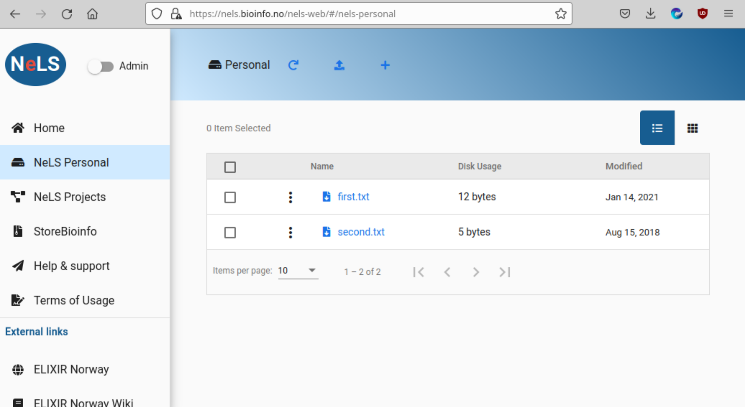
NeLS in web browser
Intuitive navigation using mouse or touchpad
Suitable only to transfer small files; not for uploading fastq or bam files
Log in with either FEIDE or Idp username

Slide 5
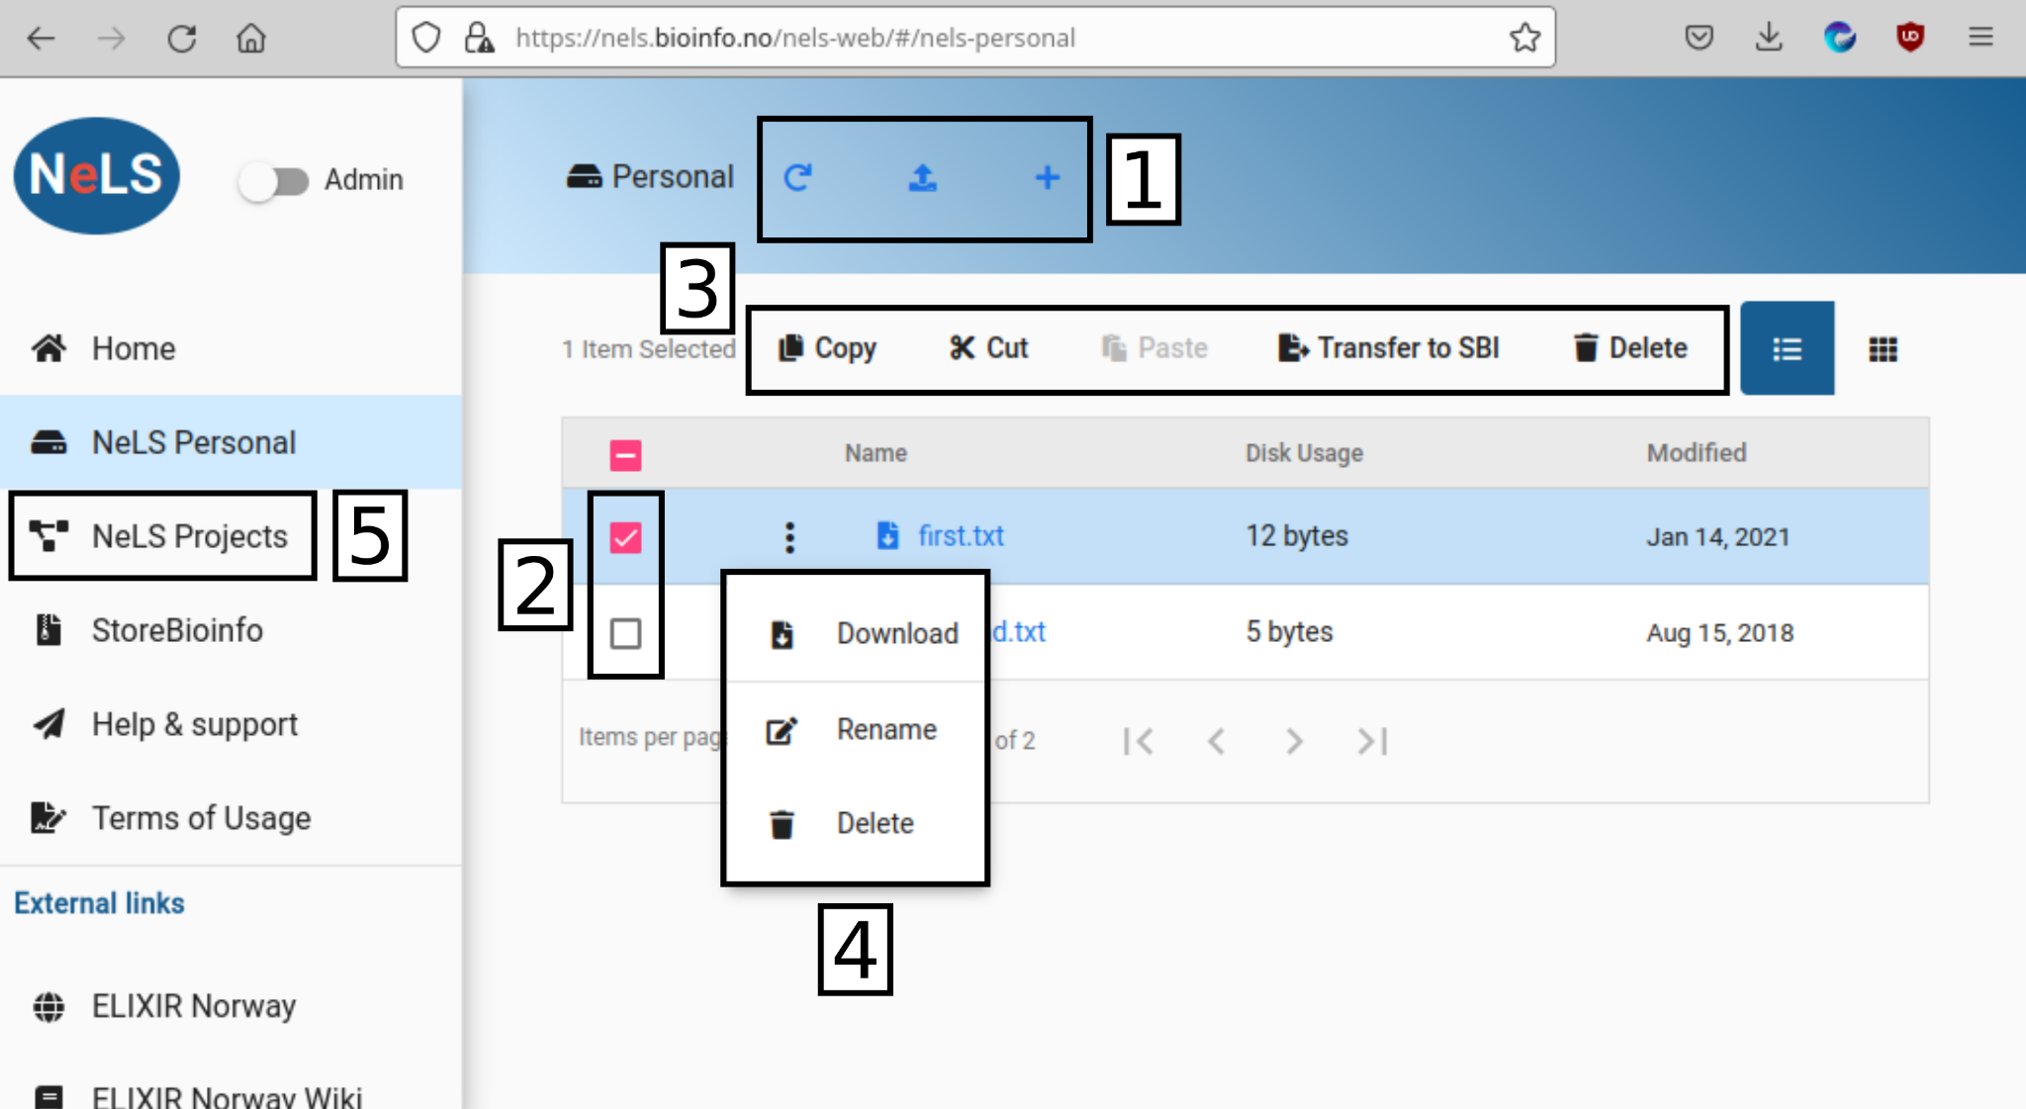
Personal Area in NeLS
1. Reload/upload/add new folder; 2. File/folder (de)selection; 3. File/folder manipulation; 4. Download/rename/delete hiding behind the three dot icon; 5. NeLS Projects - containing projects you have access to - more info later
Quotas: Personal Area - small; NeLS Projects Area - depends on the projects

Slide 6
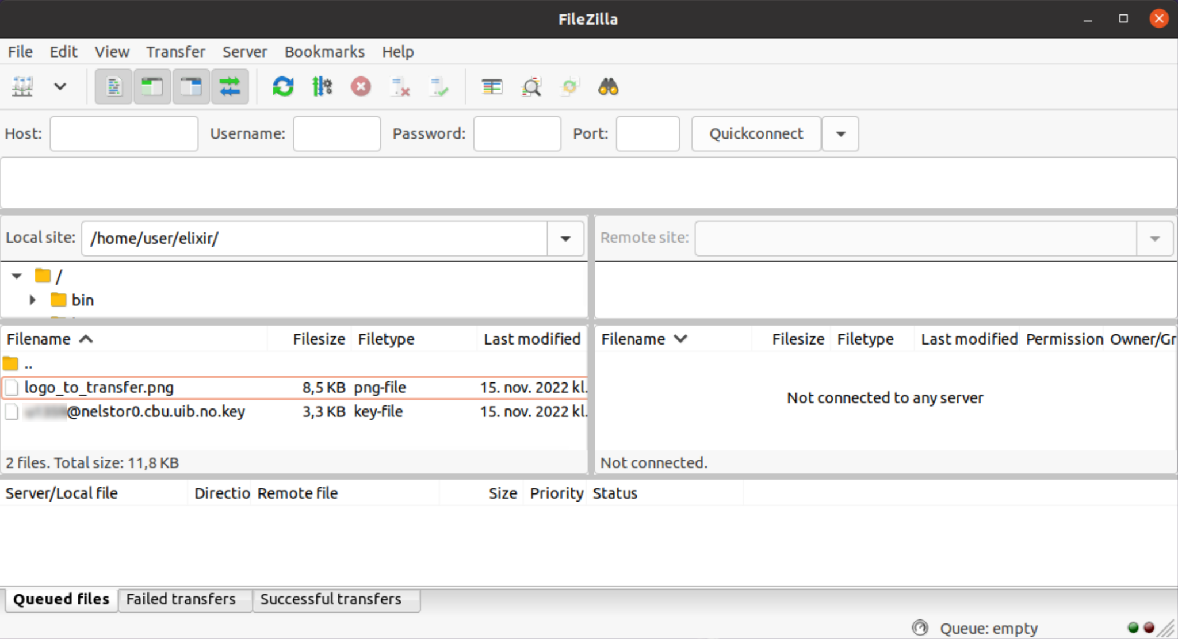
FileZilla - Introduction
A file manager tool with functionality to handle connections to remote servers.
After proper setup of a connection, file transfer is done by dragging and dropping
selected files between two areas - Local site (left) and Remote site (right).
Suitable to transfer large files.
Similar tools: winSCP, sshfs,...

Slide 7
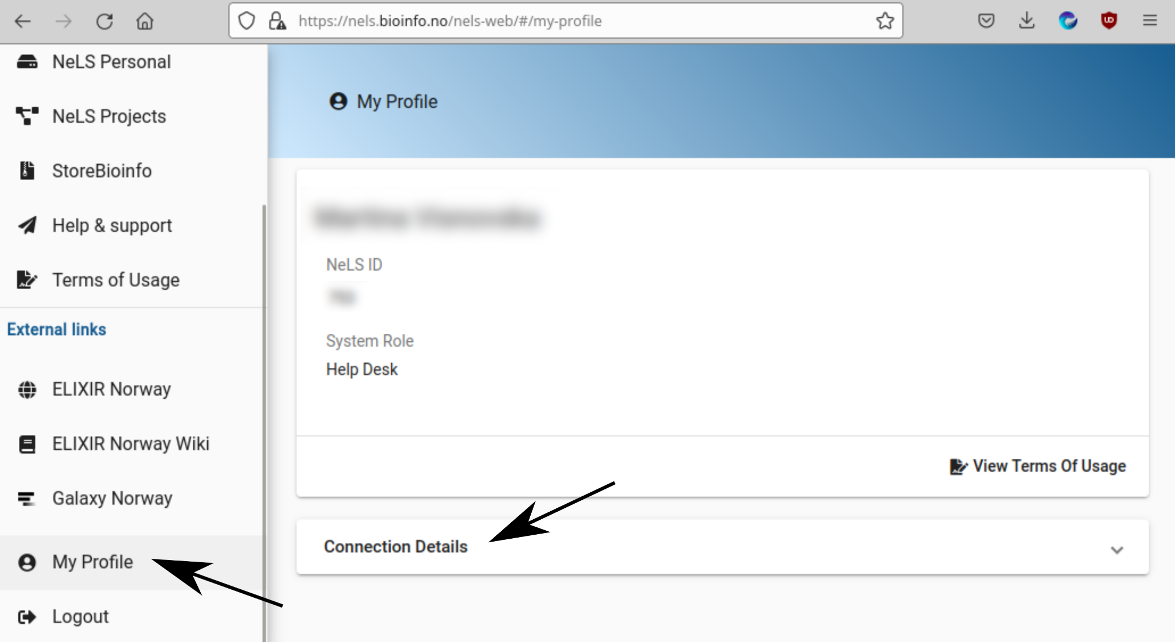
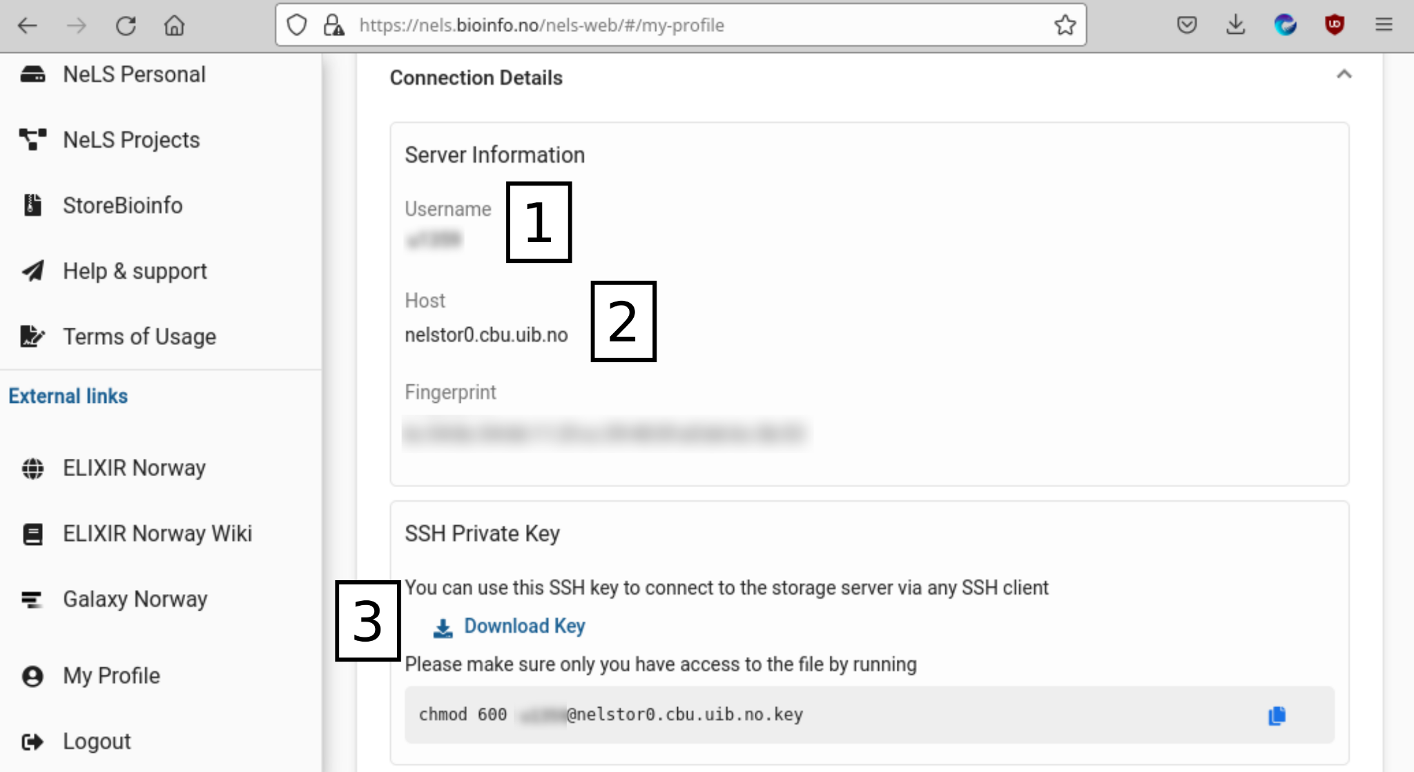
FileZilla - Setup 1
From NeLS web: Setting > Connection Details:
We will need the following details: User (1), Host (2), and Key File (3).
The Key File has to be downloaded to your computer.

Slide 8
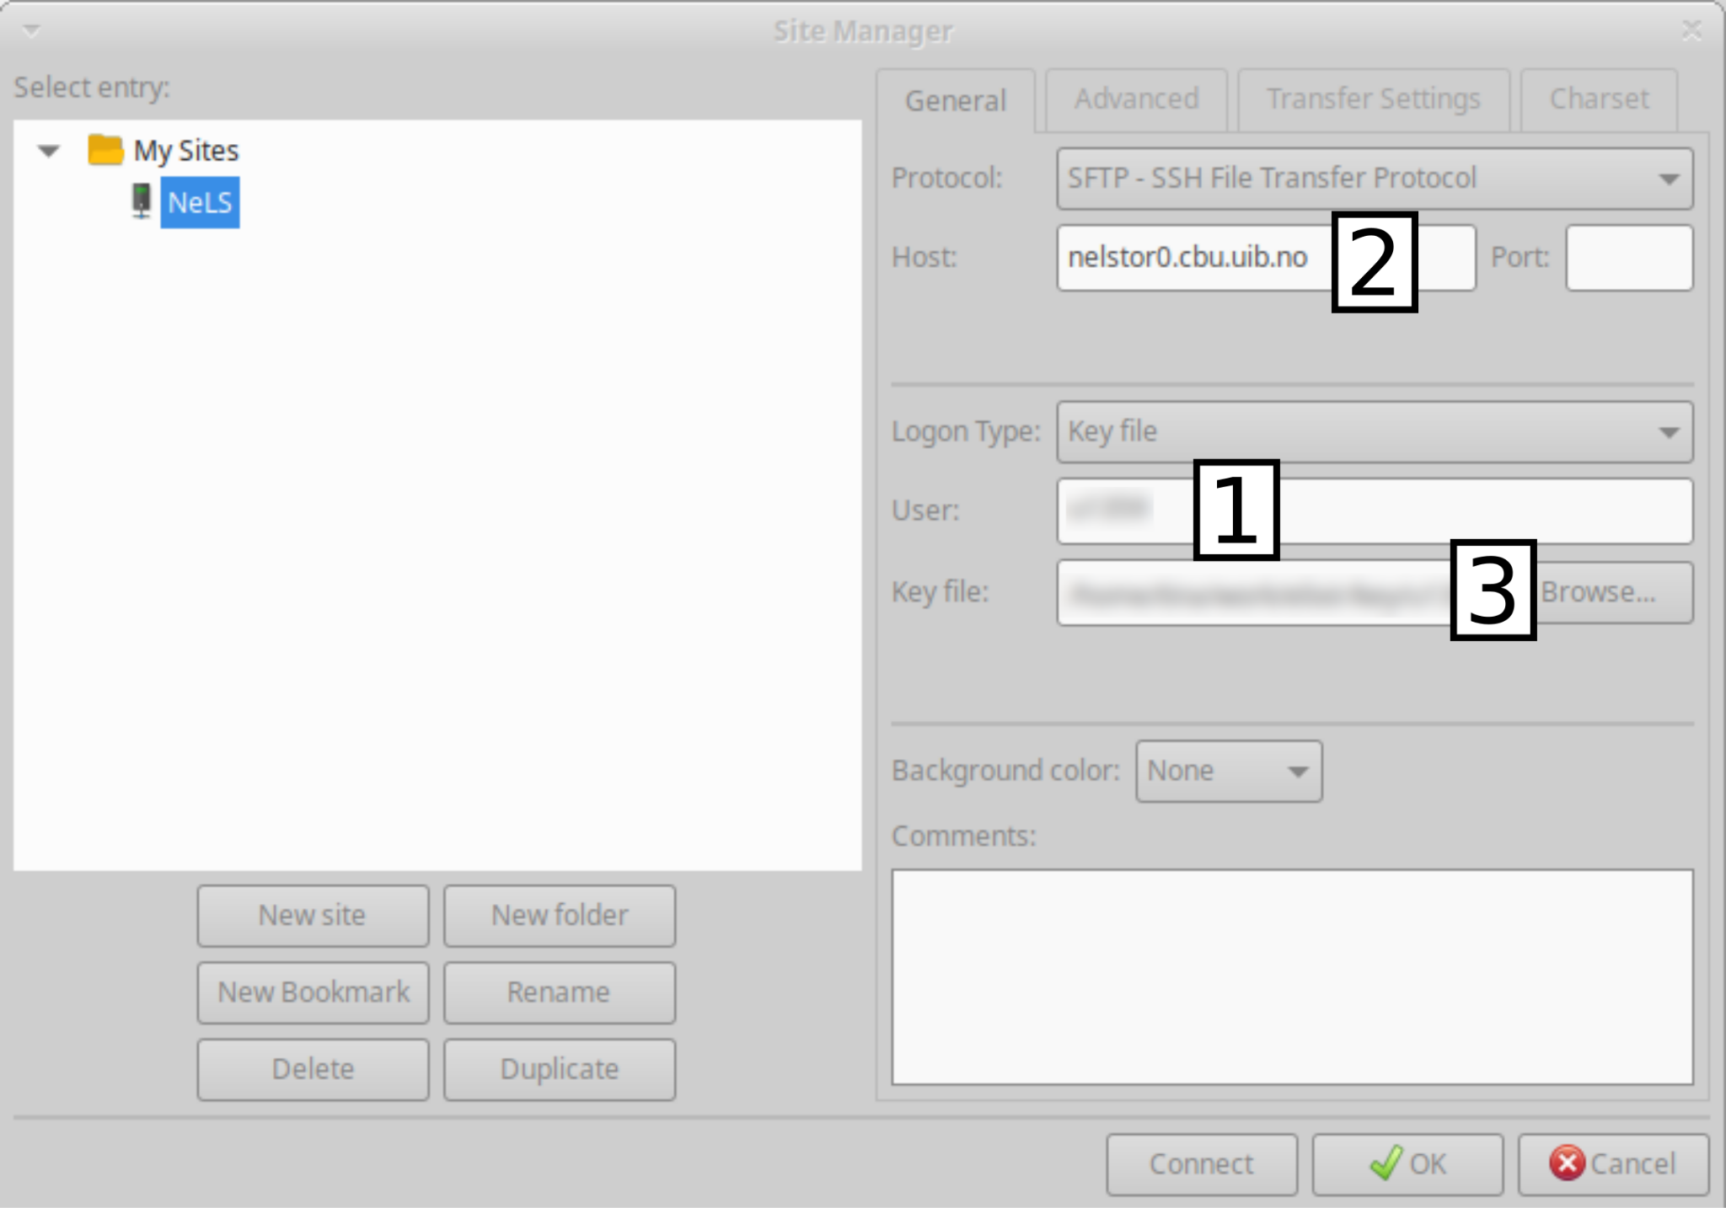
FileZilla - Setup 2
In FileZilla - setup connection to a new site:
Go to File > Site Manager > New Site
Rename the New Site to
NeLS and fill in the following info:
Protocol: SFTP - SSH File Transfer Protocol
Logon Type: Key File
Host, User, and Key File
- from the NeLS Connection Details
Press the Connect button to initiate
connection to the NeLS server.

Slide 9
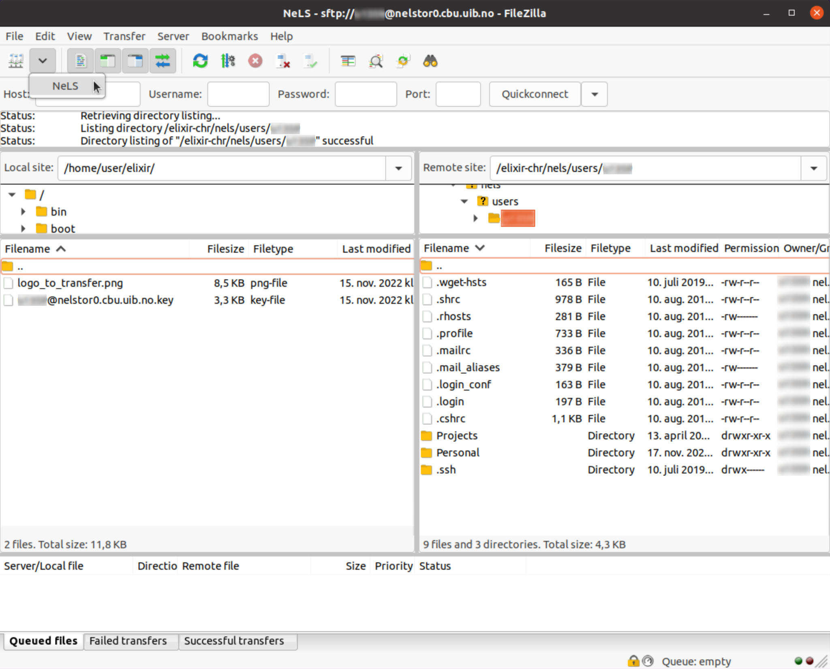
FileZilla - Established Connection
When the connection to NeLS is established, FileZilla shows content of the local computer in the left-hand side window and content of NeLS server in the right-hand side window.
For the future connections: shortcut to the NeLS connection is via the highlighted NeLS pop-up button.

Slide 10
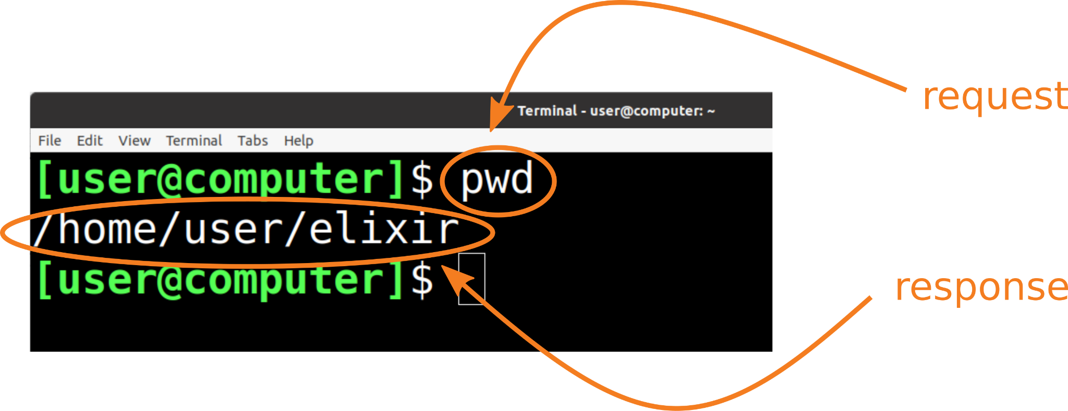
Using commands in terminal window
(optional)
Terminal facilitates dialogue between a user and a computer:
The user types in a request (command), presses enter and the computer executes the command and prints its response to the screen (if needed).
When the computer is done
answering, the user can
make another request.
Further screenshots of a
terminal window will be
capturing such a dialogue.

Slide 11
Selection of command-line tools
(optional)
pwd (print working directory):
a command that prints the working directory
ls (list directory content):
a command that prints content of the specified directory
cd (change directory):
a command that changes a directory to a directory is specified in the command
ssh (secure shell):
a command to securely log into a remote server
in combination with commands pwd, ls, and cd we can get overview of the accessible content on a remote server
scp (secure copy):
a command to securely copy data to and from a remote server

Slide 12
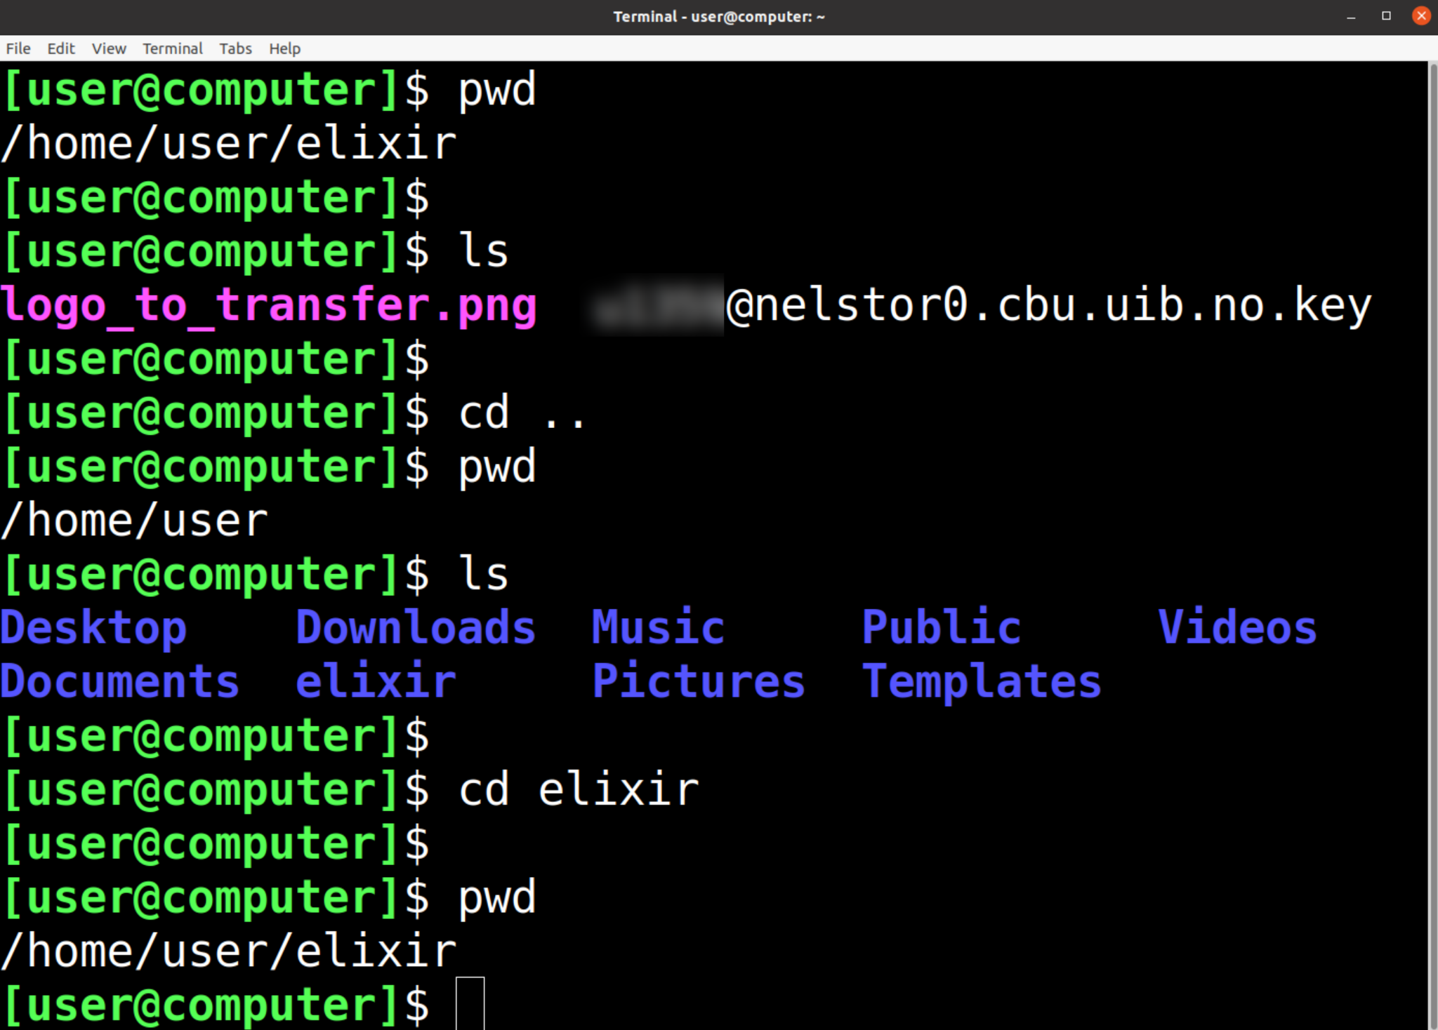
Using pwd, ls, and cd locally
(optional)
Working directory is called elixir. It is located in my home folder tina which is located in the home folder.
cd .. - go one folder up
cd <folder_name>

Slide 13
Preliminaries for ssh and scp
(optional)
Knowing User (1) and Host (2) from NeLS Connection Details.
User: <user>
Host: nelstor0.cbu.uib.no
SSH Private Key (3) downloaded from NeLS.
Change file mode of the SSH Private Key in a terminal with chmod command as suggested in the NeLS download details:
chmod 600 <user>@nelstor0.cbu.uib.no.key
chmod (change file mode bits) - modifies permissions to write and read a file and to execute it, more details about how to do this will be presented in the practical exercises.

Slide 14
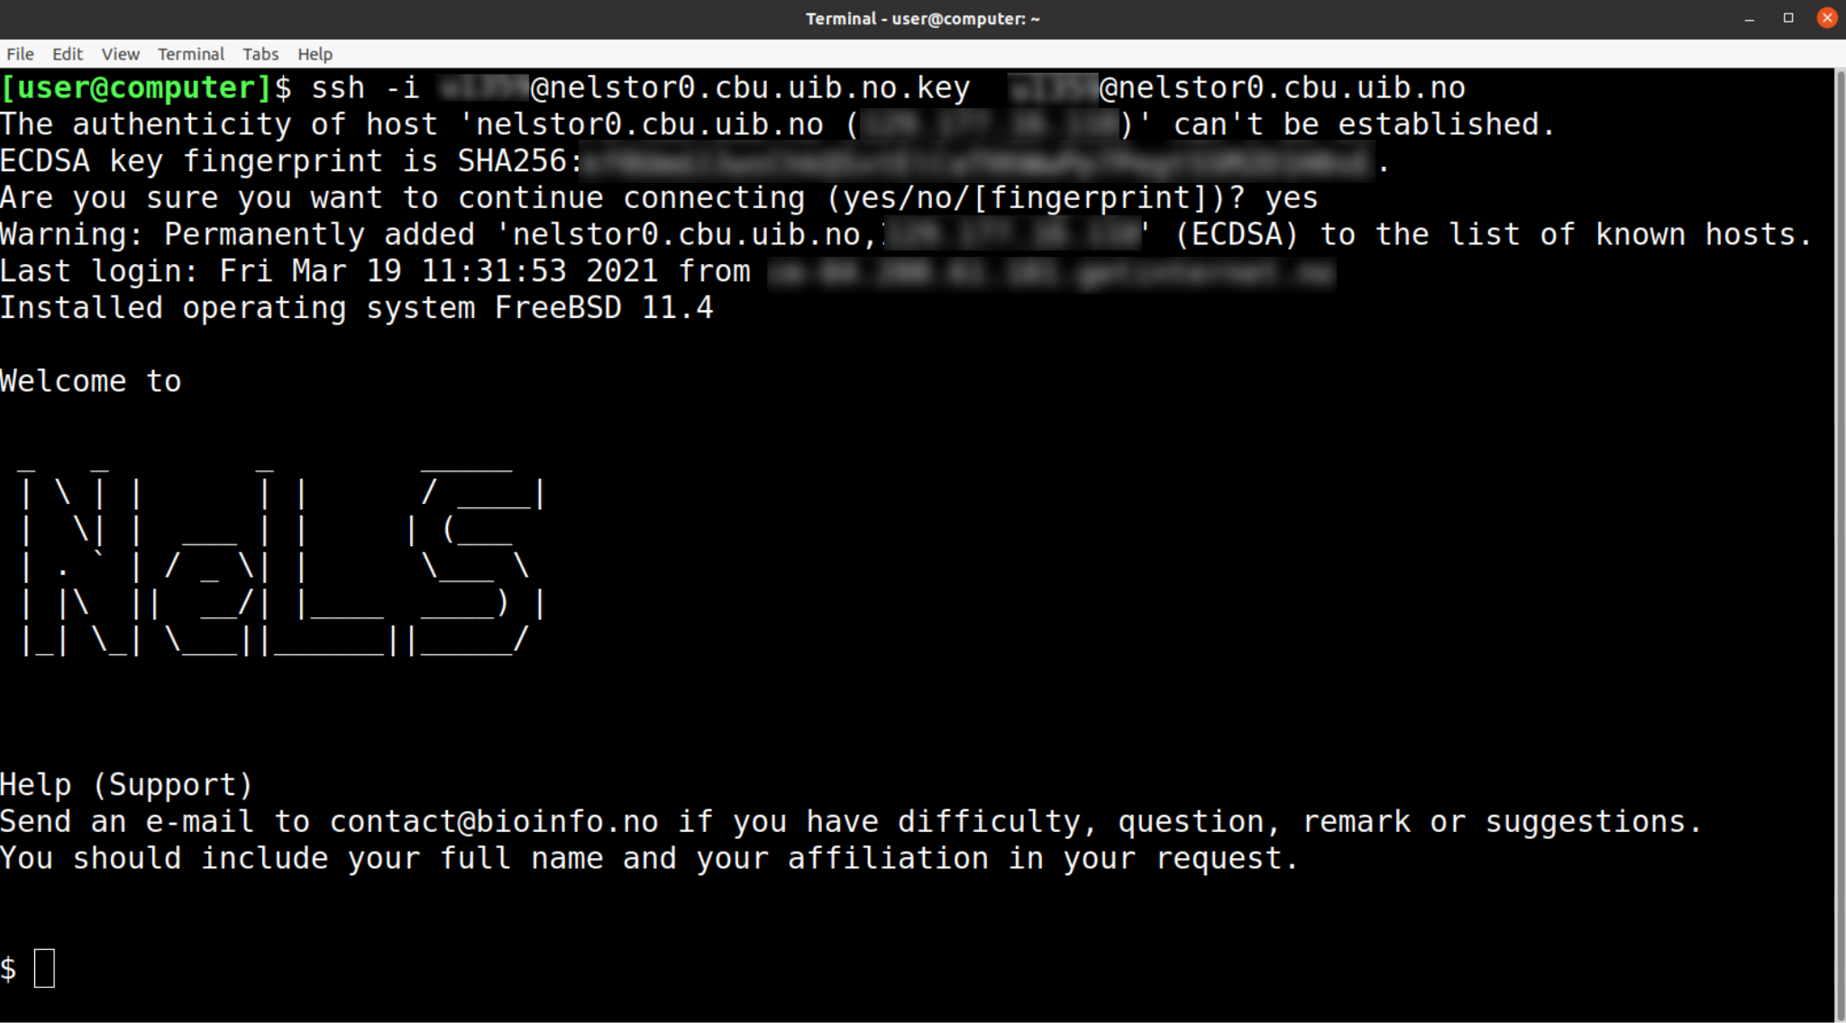
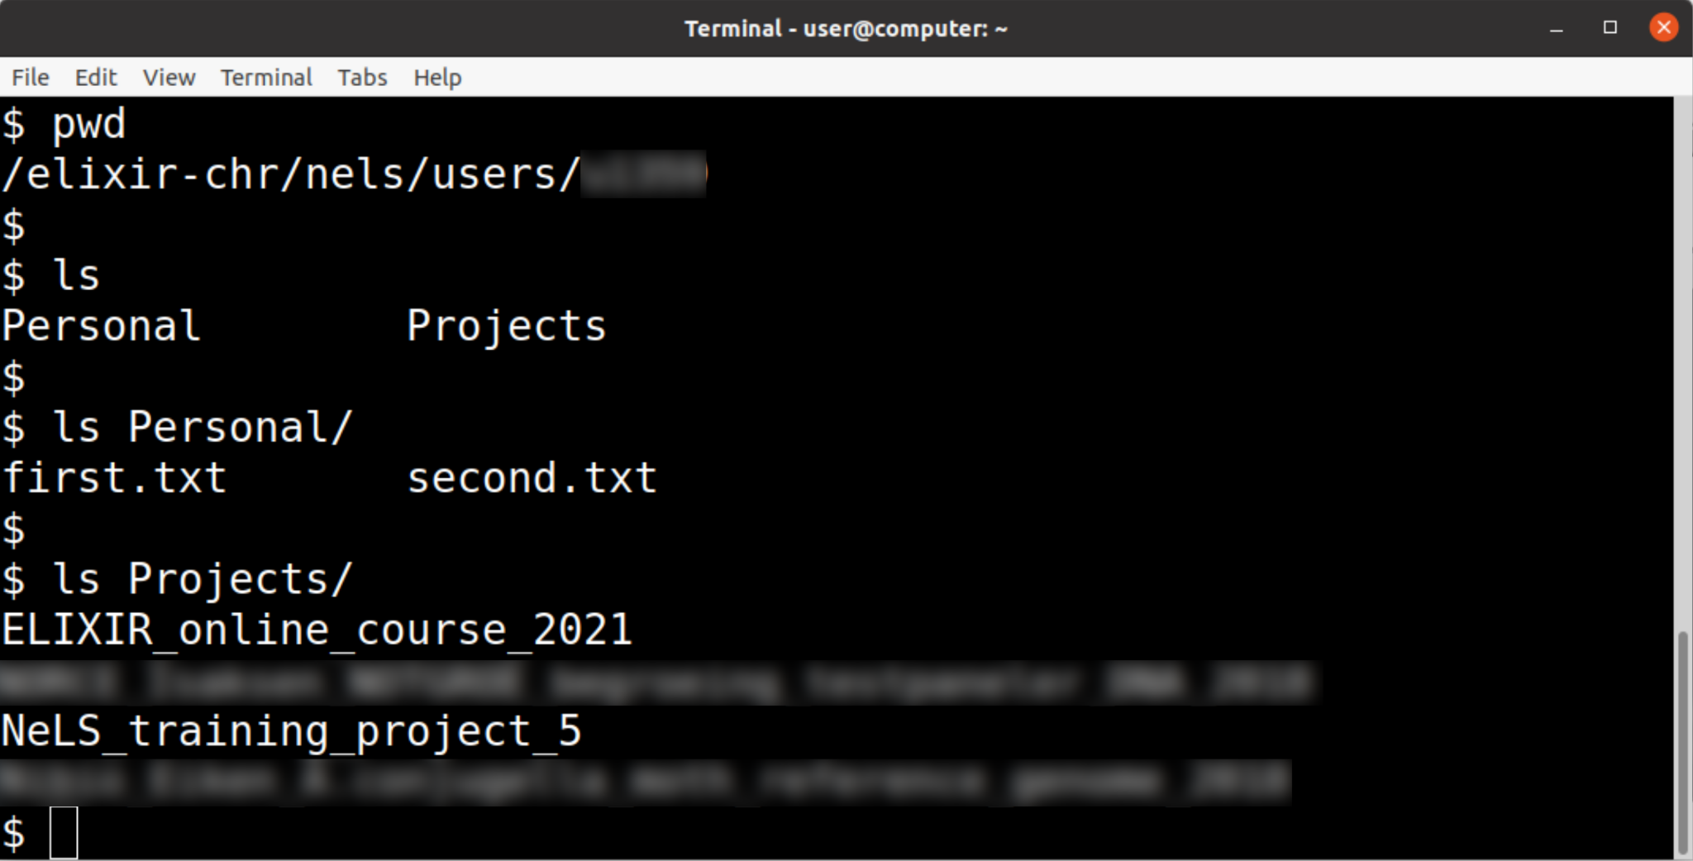
Using ssh to log into NeLS
(optional)
authentication who@whereToConnect
ssh -i <key_file> <user>@<host/server>
ssh -i <user>@nelstor0.cbu.uib.no.key <user>@nelstor0.cbu.uib.no

Slide 15
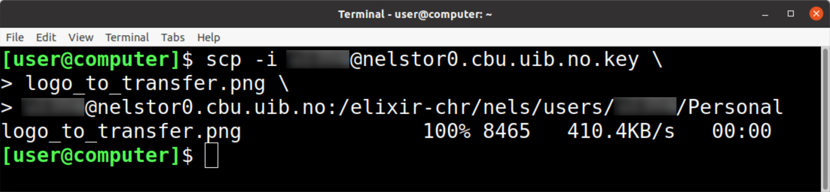
Using scp to transfer data to NeLS
(optional)
authentication whatToTransferLocal whereToTransferRemote
scp -i <key_file> <local_file> <user>@<host/server>:<destination>
scp -i <user>@nelstor0.cbu.uib.no.key \
logo_to_transfer.png \
<user>@nelstor0.cbu.uib.no:/elixir-chr/nels/users/<user>/Personal

Slide 16
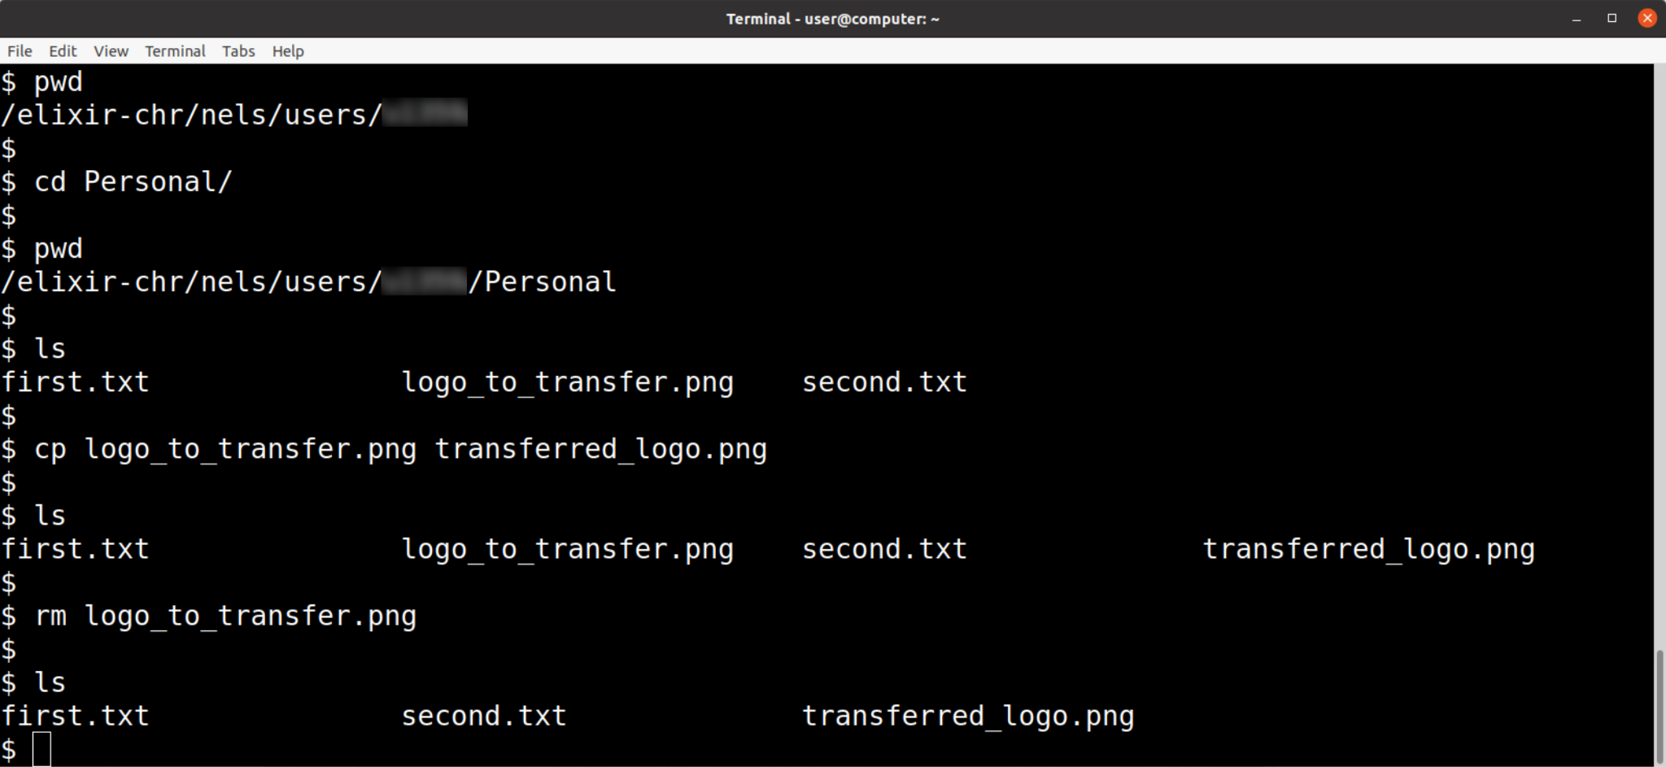
(optional)
More commands
cp: copy a file
mv: move (rename) a file
rm : remove a file - be careful, not reversible
do not use ‘rm -r’ first couple of years
mkdir: make directory
Help on a command usage:
search through internet for
<cmd> command usage examples
While ssh-ing in NeLS/Personal

Slide 17
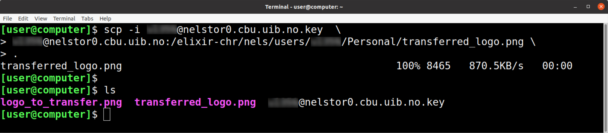
Using scp to transfer data from NeLS
(optional)
authentication whatToTransferRemote whereToTransferLocal
scp -i <key_file> <user>@<host/server>:<file_path> <local_destination>
scp -i <user>@nelstor0.cbu.uib.no.key \
<user>@nelstor0.cbu.uib.no:/elixir-chr/nels/users/<user>/Personal/transferred_logo.png \
.
“..” - one folder up, “.” - this folder

Slide 18
Questions, comments
Thank you for your attention

